Slide 1



Social Media Sentiment Analysis Dashboard using Power BI
Name : Sairathna M

Slide 2

Learning Objectives
The goal of this project is to examine sentiment distribution, engagement metrics, and social media trends on sites like Facebook, Instagram, and Twitter. The dashboard gives insights into social media performance by displaying important metrics including likes, retweets, hashtag trends, and engagement by nation.
GOAL
Source :
www.freepik.com/

Slide 3
Tools and Technology used
Power BI : For creating insights, interactive dashboards, and visualizing data.
Kaggle : Social media interactions, including as likes, retweets, sentiment scores, and hashtags, make up the Kaggle dataset. It offers a wealth of information about user activity on many platforms.

Slide 4
Methodology
Bar Charts:
Used to compare average retweets across different sentiments.
Also used for sum of retweets by hashtag, showing the most engaging hashtags.
Pie Chart:
Shows the proportion of likes received on different platforms (Instagram, Facebook, Twitter).
Donut Chart (Circular Representation of Pie Chart):
Used to represent sum of likes by hashtags and their relative popularity.
Line Chart:
Displays average retweets by country, helping to identify engagement levels by region.
Treemap Chart:
Provides a hierarchical view of likes received by country, making it easier to compare engagement.
Card Visuals:
Displays Total Count of Countries (732) to summarize dataset coverage.
Slicer (Filter Visuals):
Allows selection of different years (2010–2018) to analyze engagement trends over time.

Slide 5
Problem Statement:
Which platform (Instagram, Twitter, Facebook) receives the most engagement?
How do sentiments (positive, neutral, negative) impact user engagement?
Which hashtags generate the highest likes and retweets?
How does engagement vary by country?
What are the month-wise trends in likes and retweets?
Which posts and hashtags contribute the most to social media interactions?
Determine the best-performing posts, feelings, and hashtags.
Recognize patterns in engagement across nations and platforms.
Examine monthly likes and retweet trends to identify trends.
Acquire practical knowledge on how users engage with various kinds of material.

Slide 6
Solution:
Problem Statements | Chart Type Used
Sum of Likes by Platform | Pie Chart
Sum of Likes by Hashtags | Donut Chart
Average of Likes by Country | Treemap
Average of Likes by Sentiment | Treemap
Sum of Retweets by Hashtags | Bar Chart
Average of Retweets by Sentiment | Bar Chart
Average of Retweets by Platform | Stacked Column Chart
Sum of Retweets and Sum of Likes by Sentiment | Stacked Column Chart
Average of Retweets by Country | Line Chart
Count of Country | Card Visual

Slide 7
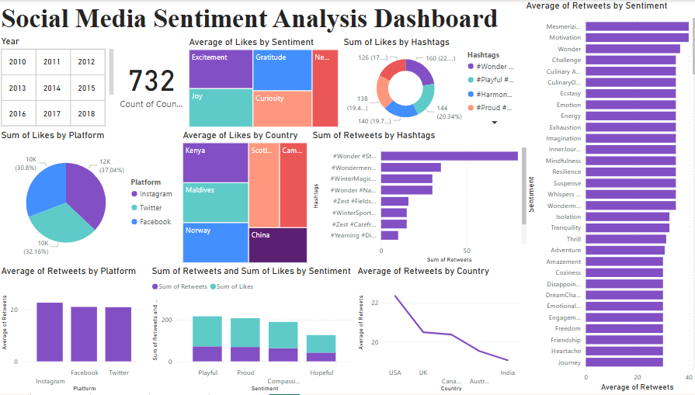
Screenshot of Output:

Slide 8
Conclusion:
This Power BI Social Media Analytics Dashboard does a good job at visualizing sentiment analysis, hashtag trends, and engagement metrics. By examining important trends, companies and influencers can:
Optimize content strategy by using hashtags that perform well.
Target particular nations with more potential for engagement.
Analyze monthly engagement data to forecast social media trends.
Improve social media efforts by utilizing platform-specific user behavior analytics.
This project showcases the ability of Power BI to extract valuable insights from social media data through interactive visualizations and real-time analytics.

